Slide 1
Topological superconductor
表面物理三组
小组成员：刘畅、刘雅卉、刘艺苑、刘林、向鹏展、骆洋、陈倩、叶晨灿
2016年11月8日

Slide 2
outline
Brief introduction to some basic concepts
Theories and Models
Example
Summary

Slide 3
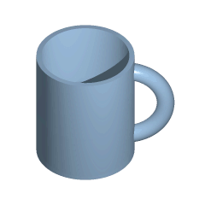
What is topology
In mathematics, topology (from the greek τόπος, place, and λόγος, study) is concerned with the properties of space that are preserved under continuous deformations, such as stretching and bending, but not tearing or gluing.

Slide 4
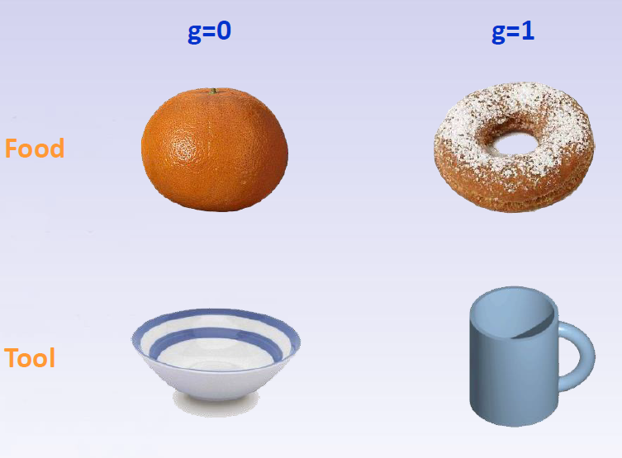
Classification of Materials

Slide 5
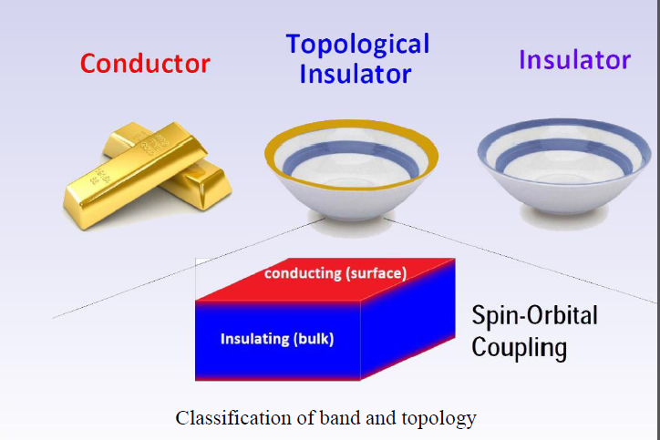
Classification of Materials

Slide 6
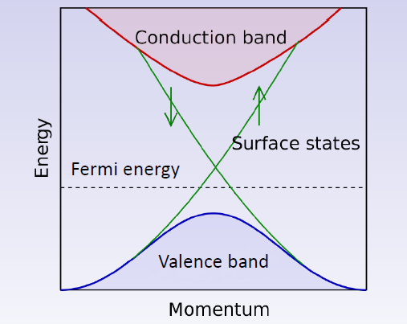
Topology in momentum space
An idealized band structure for a topological insulator

Slide 7
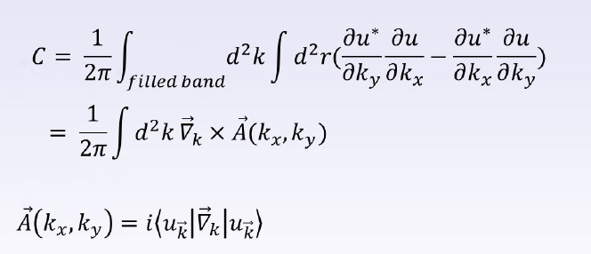
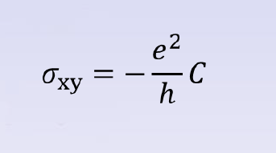
Chern number
1982年，Thouless 等人（TKNN）计算了二维周期性晶格系统的霍尔电导。这不仅揭示了整数霍尔电导的拓扑来源，而且也开启了拓扑学在凝聚态物理中应用的大门。
1983年，人们证明TKNN的第一类陈数可以被用来对定义在复数域上的任意维哈密顿量进行拓扑分类 。

Slide 8
Topological order
Order: different organizations of the atoms (or other particles) are formally called the orders in the materials.
Landau symmetry-breaking theory: As a material changes from one order to another order (i.e. phase transition), the symmetry of the organization of the atoms changes.
Topological order: In high temperature superconductor, the chiral spin state as a state that breaks the time reversal and parity symmetries, but not the spin rotation symmetry. However, it was quickly realized that there are many different chiral spin states that have exactly the same symmetry, so symmetry alone was not enough to characterize different chiral spin states. This means that the chiral spin states contain a new kind of order that is beyond the usual symmetry description. The proposed, new kind of order was named "topological order".

Slide 9
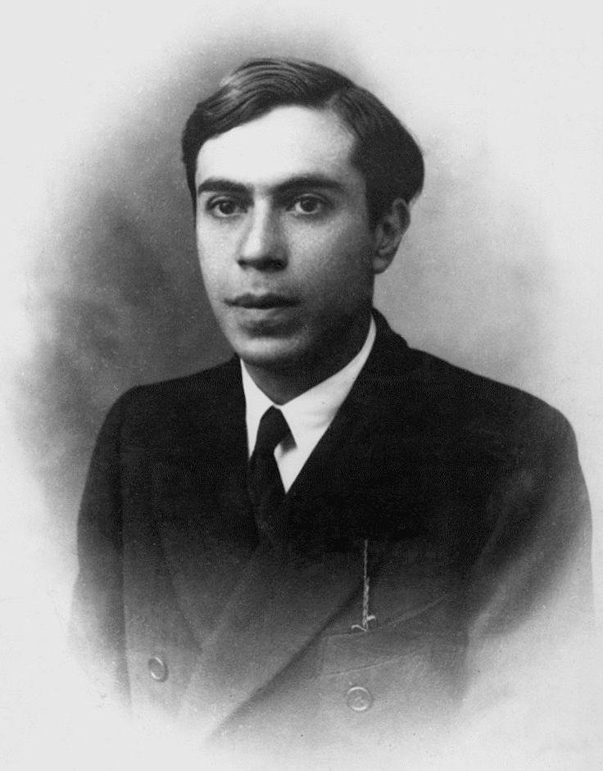
Majorana fermion
1937年，意大利物理学家 Ettore Majorana提出一种神奇的费米子，这种粒子是其本身的反粒子，没有质量、没有电荷、没有自旋，并且处于零能量态。被命名为Majorana费米子。
由于Majorana费米子服从非阿贝尔统计，可能被用于量子计算。然而几十年过去了，实验上仍然无法构造出这样一种粒子。
超导体与强自旋－轨道耦合材料之间的邻近效应，可能引出Majorana费米子。拓扑绝缘体是一种强自旋－轨道耦合材料。

Slide 10
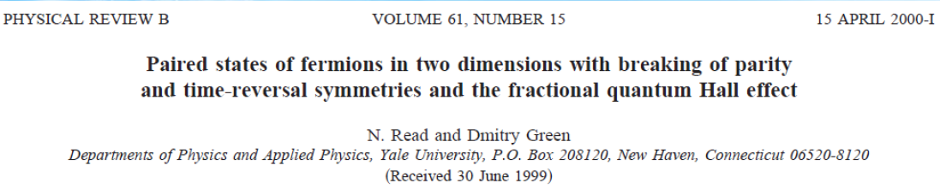
Majorana费米子和拓扑超导体的理论研究和模型
2000 年，Read 和Green 指出，某种特殊的Cooper 配对的准粒子激发可以是Majorana 费米子。在p 波超导（无自旋的px+ipy 超导体）的磁通芯（vortex core）中可能存在这样一种Majorana 束缚态
Read N, Green D. Physical Review B 61(15): 10267.(2000)

Slide 11
Majorana费米子和拓扑超导体的理论研究和模型
L= -1(p wave, spinless, or spin triplet)
The weak-pairing phase has a pair wave function that is asympototically the same as that in the moore-read (pfaffian) quantum hall state, and its other properties (edge states, quasihole, and toroidal ground states) are also the same, indicating that nonabelian statistics is a generic property of such a paired phase. The strong-pairing phase is an abelian state, and the transition between the two phases involves a bulk majorana fermion, the mass of which changes sign at the transition.
L= -2(d wave, spin singlet)
The haldane-rezayi state is not the generic behavior of a phase but describes the asymptotics at the critical point between weak and strong pairing, and has gapless fermion excitations in the bulk. In this case

Slide 12
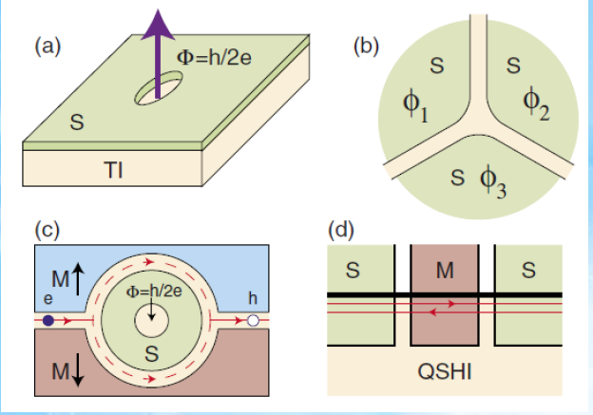
Majorana费米子和拓扑超导体的理论研究和模型
2008 年，Fu 和Kane提出当拓扑绝缘体与s 波超导体接触时，由于超导邻近效应（superconducting proximity effect），在二者的界面上会产生一种新的超导态。这种超导态一方面具有拓扑绝缘体表面态电子的手性特征，另一方面又具有超导体电子配对的特性，因此成为无自旋的类px+ipy 超导体，在其磁通芯（vortex core）处存在Majorana 束缚态。
图示为理论上能够实现Majorana费米子的超导体和其他材料（拓扑绝缘体、铁磁性材料等）的异质结构。

Slide 13
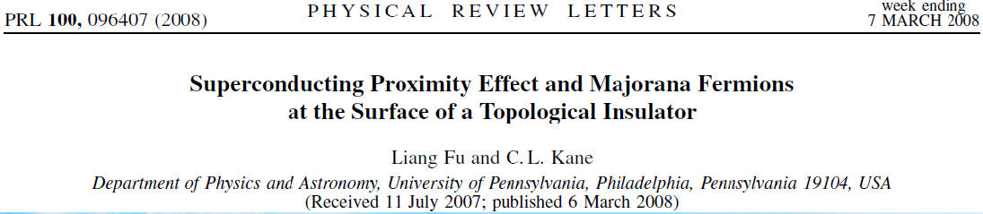
Majorana费米子和拓扑超导体的理论研究和模型
We study the proximity effect between an s-wave superconductor and the surface states of a strong topological insulator. The resulting two-dimensional state resembles a spinless px +ipy superconductor, but does not break time reversal symmetry. This state supports Majorana bound states at vortices. We show that linear junctions between superconductors mediated by the topological insulator form a nonchiral one-dimensional wire for Majorana fermions, and that circuits formed from these junctions provide a method for creating, manipulating, and fusing Majorana bound states.

Slide 14
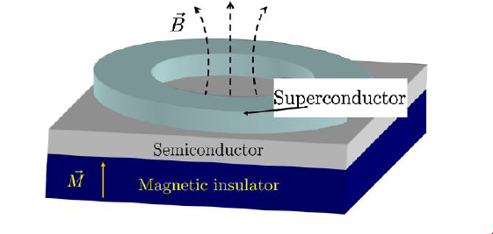
Majorana费米子和拓扑超导体的理论研究和模型
2010 年，马里兰大学的Das Sarma 小组发现拓扑绝缘体在这一模型中并不是必需的，而提出在“铁磁绝缘体 + 具有强自旋轨道耦合的半导体 + s 波超导体”的三明治结构中，在磁通芯处同样可以存在Majorana 零束缚态。
We show that a film of a semiconductor in which s-wave superconductivity and Zeeman splitting are induced by the proximity effect, supports zero-energy Majorana fermion modes in the ordinary vortex excitations. Since time-reversal symmetry is explicitly broken, the edge of the film constitutes a chiral Majorana wire. The heterostructure we propose—a semiconducting thin film sandwiched between an s-wave superconductor and a magntic insulator—is a generic system which can be used as the platform for topological quantum computation by virtue of the existence of non-Abelian Majorana fermions.
Sau J D, Lutchyn R M, Tewari S, et al. Physical review letters 104(4): 040502.(2010)

Slide 15
Majorana费米子和拓扑超导体的理论研究和模型
随后Das Sarma小组提出了一个更容易实现的体系：将一根半导体材料的纳米线放置在s 波超导体之上，邻近效应将在纳米线中诱导出p 波配对，再加上一个平行于纳米线的塞曼磁场来破坏时间反演对称性。当施加的磁场强度和半导体纳米线中的费米能满足一定条件时，纳米线的两端就会出现Majorana零束缚态。

Slide 16
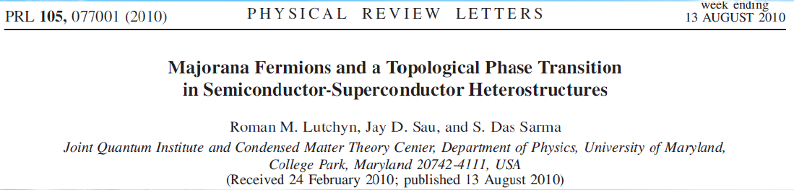
Majorana费米子和拓扑超导体的理论研究和模型
We propose and analyze theoretically an experimental setup for detecting the elusive Majorana particle in semiconductor-superconductor heterostructures. The experimental system consists of one-dimensional semiconductor wire with strong spin-orbit Rashba interaction embedded into a superconducting quantum interference device. We show that the energy spectra of the Andreev bound states at the junction are qualitatively different in topologically trivial (i.e., not containing any Majorana) and nontrivial phases having an even and odd number of crossings at zero energy, respectively. The measurement of the supercurrent through the junction allows one to discern topologically distinct phases and observe a topological phase transition by simply changing the in-plane magnetic field or the gate voltage. The observation of this phase transition will be a direct demonstration of the existence of Majorana particles.

Slide 17
Majorana费米子和拓扑超导体的理论研究和模型
This particular heterostructure consisting of an ordinary superconductor (e.g., Nb) and a semiconductor with strong spin-oit coupling (e.g., InAs) (a)Top view of SM/SC heterostructure embedded into small-inductance SC loop. (b) Side view of the SM/SC heterostructure. The nanowire can be top gated to control chemical potential. Here we assume L<<ξ and L1>>ξ with ξ being the SC coherence length. (c) Proposed readout scheme for the Andreev energy levels. Inductively coupled rf -driven tank circuit allows time-resolved measuring of the effective state dependent Josephson inductance

Slide 18
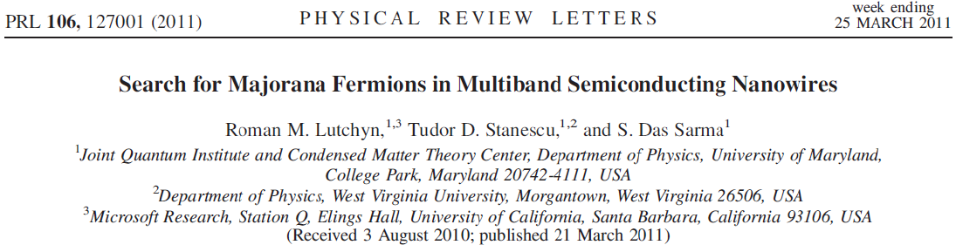
随后， Das Sarma 在2011年又连续提出两种不同模型
We study multiband semiconducting nanowires proximity-coupled with an s-wave superconductor. We show that, when an odd number of subbands are occupied, the system realizes a nontrivial topological state supporting Majorana modes. We study the topological quantum phase transition in this system and calculate the phase diagram as a function of the chemical potential and magnetic field. Our key finding is that multiband occupancy not only lifts the stringent constraint of one-dimensionality but also allows one to have higher carrier density in the nanowire, and as such multisubband nanowires are better suited for observing the Majorana particle. We study the robustness of the topological phase by including the effects of the short- and long-range disorder. We show that there is an optimal regime in the phase diagram (‘‘sweet spot’’) where the topological state is to a large extent insensitive to the presence of disorder.

Slide 19
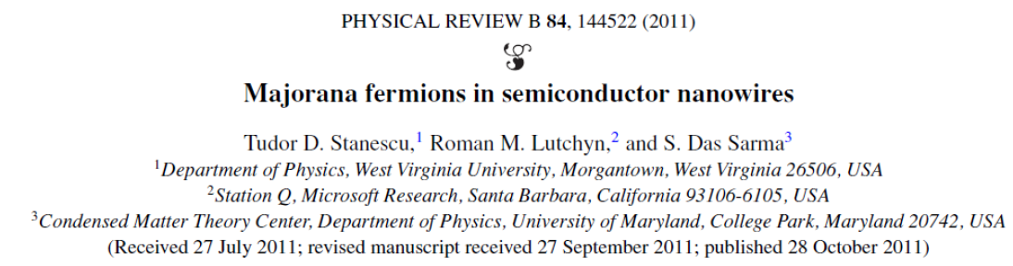
Our work establishes the realistic likelihood of the existence within laboratory conditions of the non-Abelian Majorana zero-energy mode in spin-orbit interacting SM nanowires proximity-coupled to ordinary SCs. We also establish that tunneling spectroscopy is one of the easiest techniques to directly observe the elusive Majorana in realistic solid-state systems. Greater challenges, such as carrying out topological quantum computation, lie ahead once the laboratory existence of the Majorana mode is established experimentally.

Slide 20
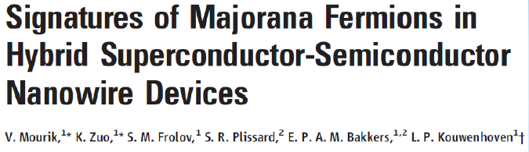
2012 年，荷兰Kouwenhoven 小组利用一维Insb 纳米线实现了这一系统，并且探测到零偏压电导峰，而零偏压电导峰正是实验上寻找Majorana 束缚态的一个判据。

Slide 21
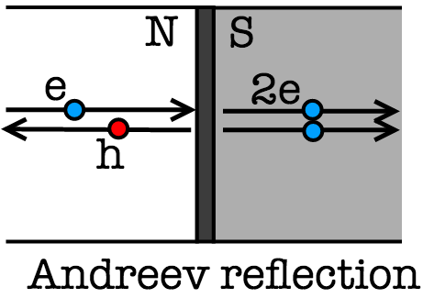
考虑一个常规导体和一个非拓扑的超导体连起来，我们可以想象：在施加电压比较小的时候，电子不能进入超导体，因为超导体是有能隙的，施加电压不足以越过这个能隙的话电流就被禁止。但是有一种机制叫做Andreev Reflection，意思是在界面上，从导体处入射一个电子，出射一个空穴，同时在超导体内部有两个电子形成的Cooper对形成并传播。这种机制是满足能量守恒的。
现在，把超导体换成拓扑超导体，其边界存在零能激发态Majorana Zero Mode。由于与导体相连接，我们可以认为它『波函数渗透到了导体内』。在零偏压的时候，这个零能激发态与零偏压下的入射电子（其实这个概念有点模糊，就这么理解吧）共振，会出现一个电导极大，就成为零偏压电导峰。

Slide 22
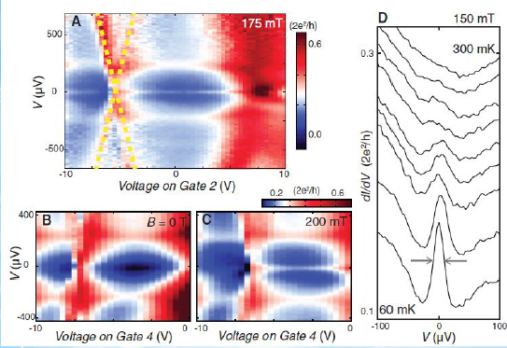
Gate-voltage dependence. (A) A 2D color plot of di/dv versus V and voltage on gate 2 at 175 mt and 60 mk. Andreev bound states cross through zero bias, near –5 V (yellow dotted lines). The ZBP is visible from –10 to ~5 V. Split peaks are observed in the range of 7.5 to 10 V . in (B) and (C), comparition voltage sweeps on gate 4 for 0 and 200 mt with the ZBP absent and present, respectively. Temperature is 50 mk. (D) temperature dependence. Di/dv versus V at 150 mt. Traces have an offset for clarity (except for the lowest trace) and are taken at different temperatures (from bottom to top: 60, 100, 125, 150, 175, 200, 225, 250, and 300 mk

Slide 23
ExperimenT
CuxBi2se3
FeSe
FeTeSe

Slide 24
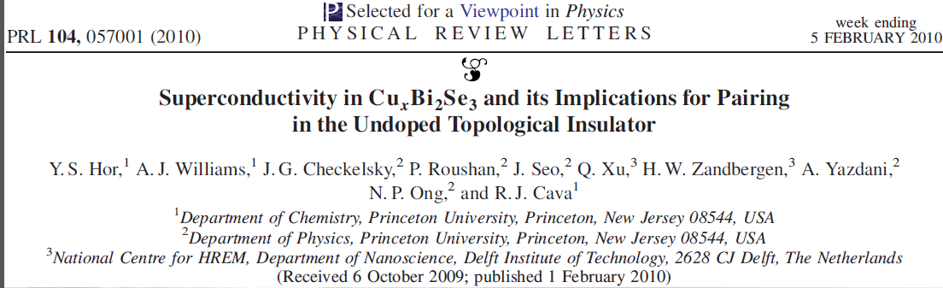
CuxBi2Se3材料的研究工作
Bi2Se3 is one of a handful of known topological insulators. Here we show that copper intercalation in the van der Waals gaps between the Bi2Se3 layers, yielding an electron concentration of ≈2 *10^20 cm-3, results in superconductivity at 3.8 K in CuxBi2Se3 for 0.12 < x< 0.15. This demonstrates that Cooper pairing is possible in Bi2Se3 at accessible temperatures, with implications for studying the physics of topological insulators and potential devices.

Slide 25
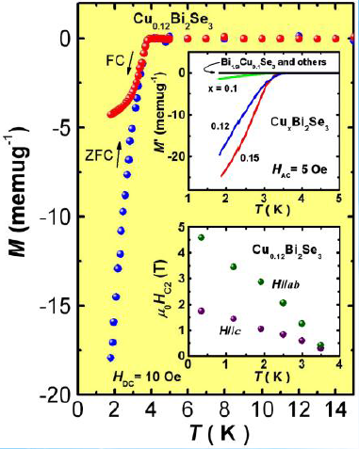
CuxBi2Se3材料的研究工作
The temperature dependent magnetization of a single crystal of Cu0.12Bi2Se3 shows a superconducting transition Tc≈3.8 K in zero field cooled (ZFC) and field cooled (FC) measurements.
Upper inset: superconductivity occurs only in a narrow window of x in CuxBi2Se3. Superconductivity is not found for x< 0.1 and x > 0.3, or in Bi2xCuxSe3, Cu2Se, CuBi3Se5, BiCuSe2, and BiCu3Se3 (data labeled in inset as ‘‘Bi1.9Cu0.1Se3 and others’’).
Lower inset: temperature dependence of the superconducting upper critical field, Hc2(T) of Cu0.12Bi2Se3 for the magnetic field applied parallel to the caxis and parallel to the ab plane.
PRL 107, 217001 (2011)

Slide 26
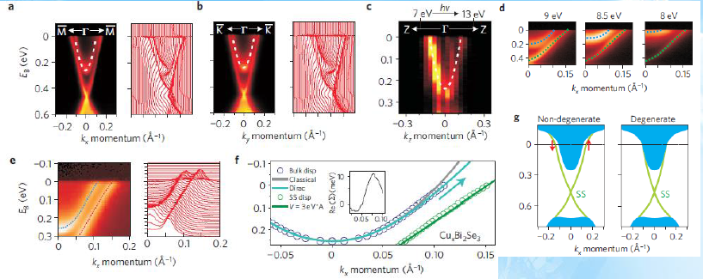
Band topology at the superconducting composition. a,b, Momentum dependence of the bulk and surface conduction bands in superconducting Cu0.12Bi2Se3 measured with low-energy (9.75 eV) photons for enhanced bulk sensitivity. c, Dispersion along the z axis, examined by varying incident photon energy. d, Bulk and surface bands remain separate at intermediate kz values. e,f, Energy of the bulk electrons compared with Dirac (vC=6 eV Å) and classical (parabolic) fits with a mass of 0.155Me. Surface-state (SS) dispersion is also plotted. Inset: Self-energy with respect to the Dirac fit. g, The surface electronic structure presents a non-trivial topological setting for superconductivity because (green) surface and (blue) bulk bands do not overlap.

Slide 27
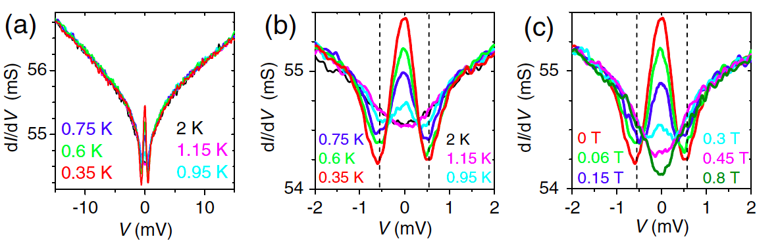
CuxBi2Se3材料的研究工作
We report that the point-contact spectra on the cleaved surface of superconducting CuxBi2Se3 present a zero-bias conductance peak (ZBCP) which signifies unconventional superconductivity. Theoretical considerations of all possible superconducting states help us conclude that this ZBCP is due to Majorana fermions and gives evidence for a topological superconductivity in CuxBi2Se3.
Notes:
Fig.2: Zero-bias conductance peak. (a) Point-contact spectra (dI/dV vs bias voltage) of Cu_{x}Bi₂Se₃ with x=0.3 for 0.35–2 K measured in 0 T for a wide energy window. (b) A narrower window of (a). (c) The spectra at 0.35 K measured in perpendicular magnetic fields of 0–0.8 T. The vertical dashed lines in (b) and (c) indicate the energy position of the dips.

Slide 28
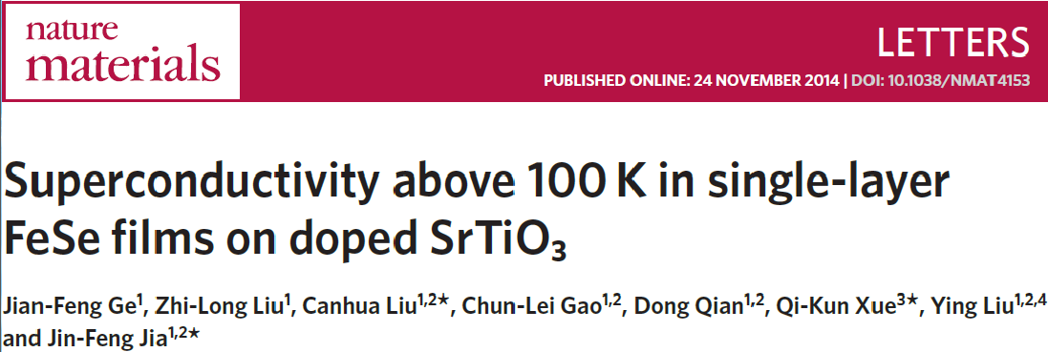
Other Examples

Slide 29
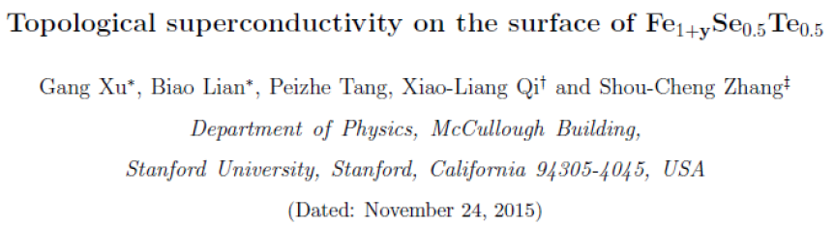
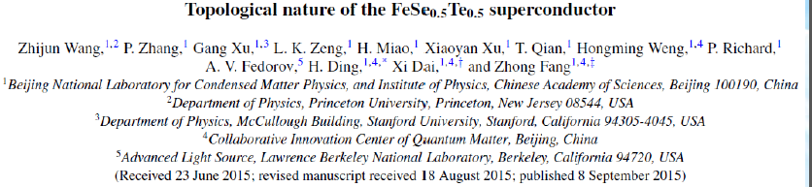
Other ExampleS

Slide 30
summary
Introduction to topology and majorana fermion.
Theories and models for topological insulator-superconductor heterostructures and semiconductor-superconductor heterostructures: Read & Green, Fu & Kane, Das Sarma, etc.
Experiment results:CuxBi2Se3、FeSe、FeTeSe, etc.

Slide 31
Thanks!

